Slide 1









Slide 2
“
The arena where creators unleash their imagination, tossing in ideas as if they're colorful confetti. It's like an art carnival where every upload is a ticket to the creativity rollercoaster. Plunge into the imaginative festivity at Bucket.com and let your ideas pour!
🎨🌟

Slide 3

What actually is a bucket ?
online platform where designers, illustrators, and other creative professionals showcase their work and projects. It's a social networking platform that allows creatives to share their design work, gain exposure, and connect with other like-minded individuals in the design community.

Slide 4
Database Design with SQL Server
Project-Methodology
3-tier application
We focused on designing an efficient and scalable database schema using SQL Server.
We created tables to store user profiles, projects, likes, comments, and other relevant data, establishing appropriate relationships and constraints.
Database Design
Front-end Development
Backend
For the user interface, Angular is our front-end framework
Our team created designs for the UI, and we should implement the design using Angular components.
We designed using HTML, CSS, Bootstrap.
UI Design
Middleware Development with C#.NET
Frontend
The middleware layer is responsible for handling business logic and application workflows.
We used C#.NET to build this layer, which allowed us to manage user authentication, project interactions, and other essential operations.
Middleware Development
Middleware layer

Slide 5
Database Design
The database design is for our project, where users can showcase their creative projects, such as design work, illustrations, photography, etc.
The database stores information about users, projects, media files associated with projects, likes given to projects, comments made on projects, tags for categorization, and the association between projects and tags.

Slide 6
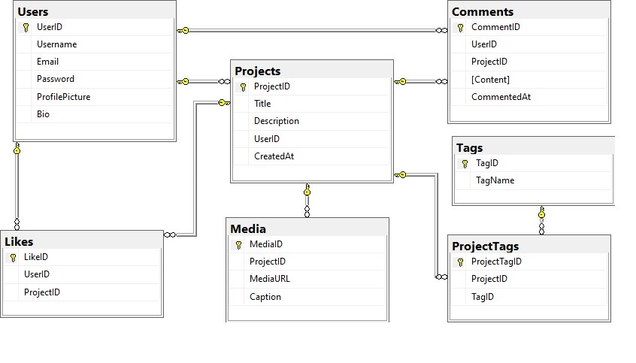
Database Schema

Slide 7
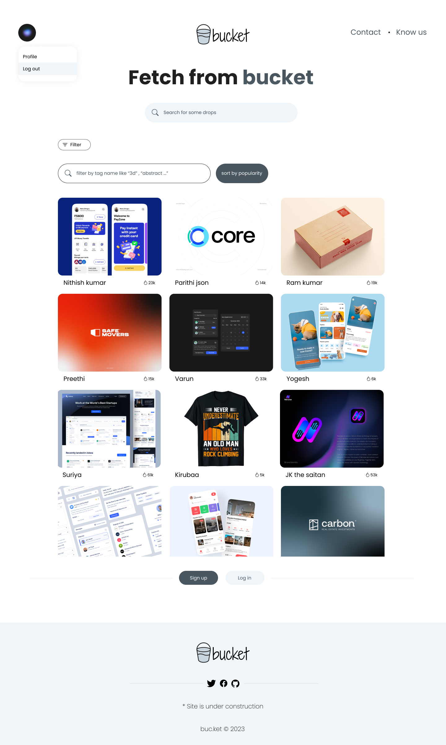



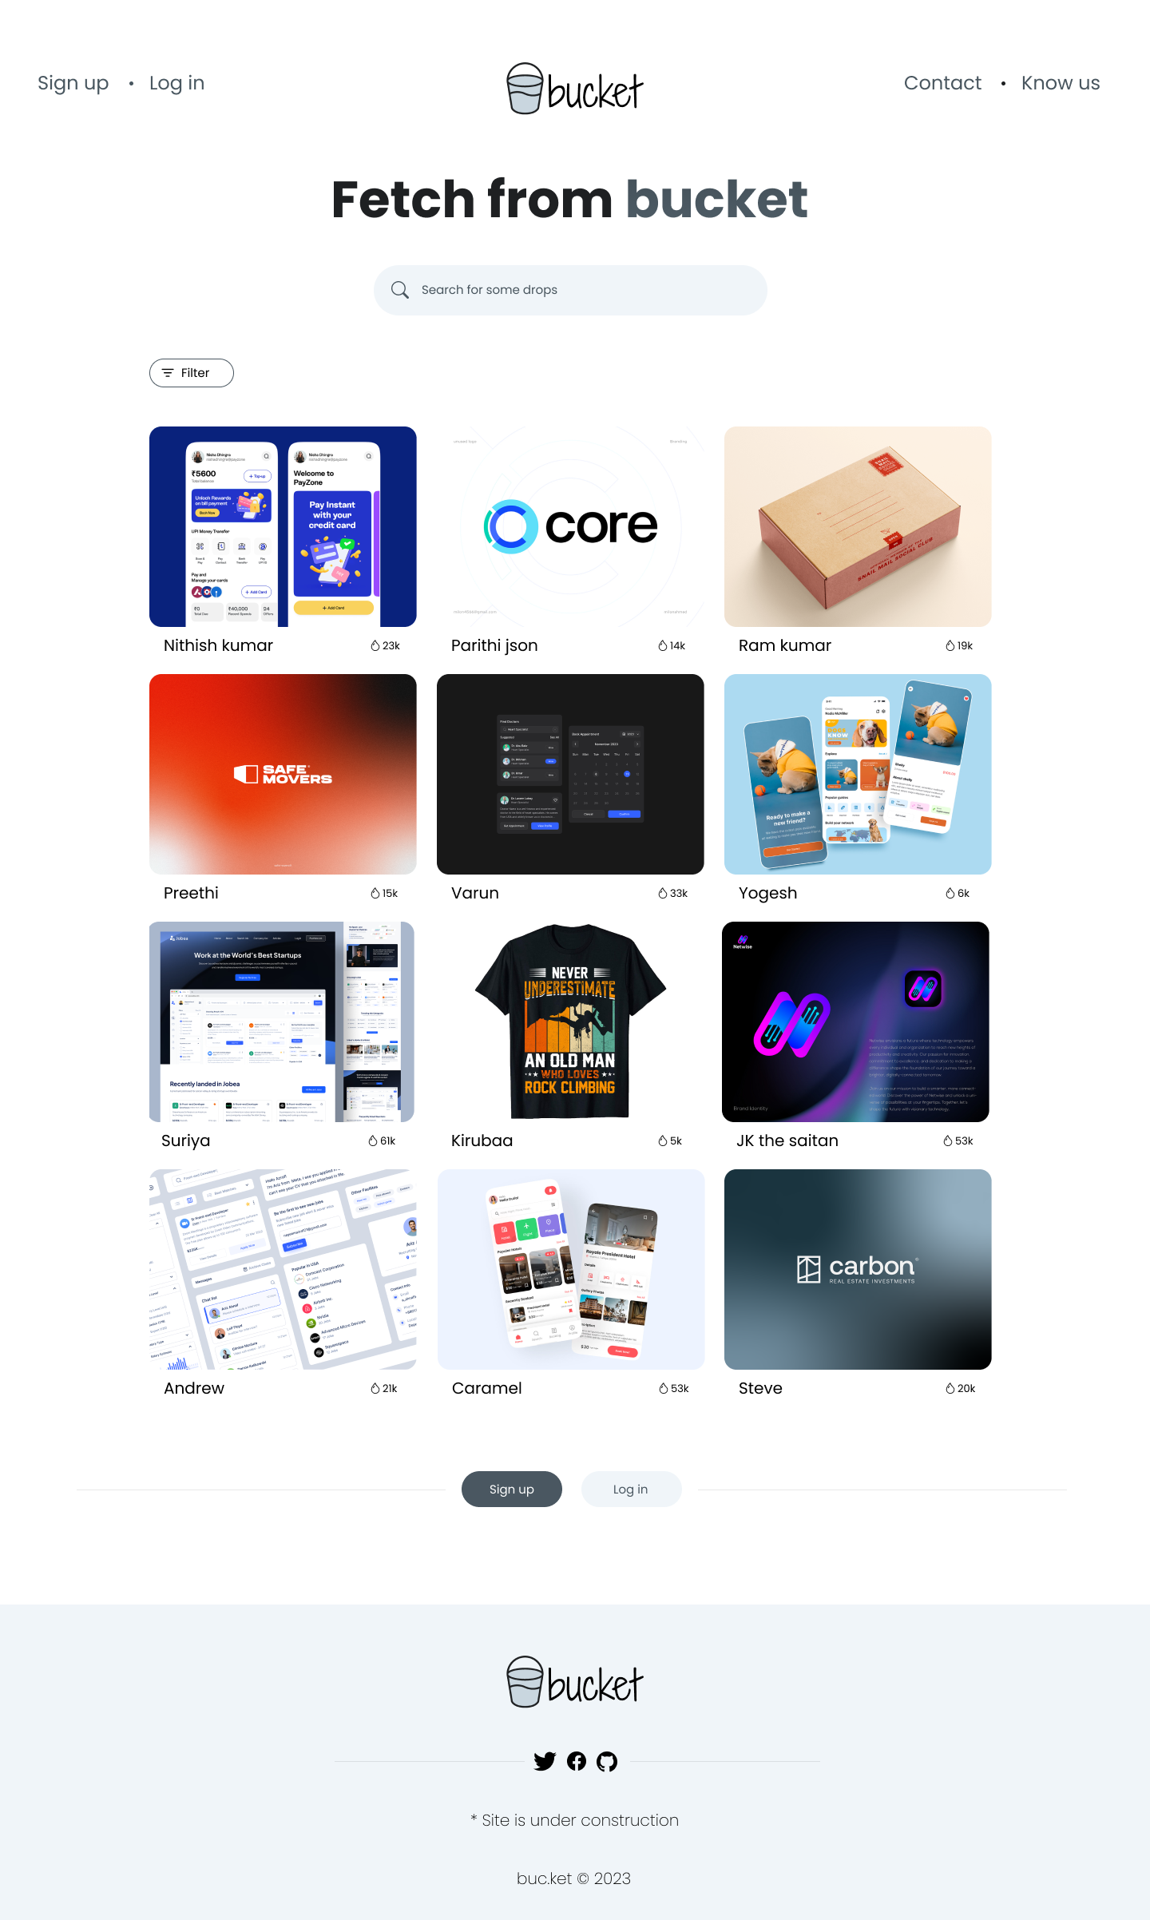
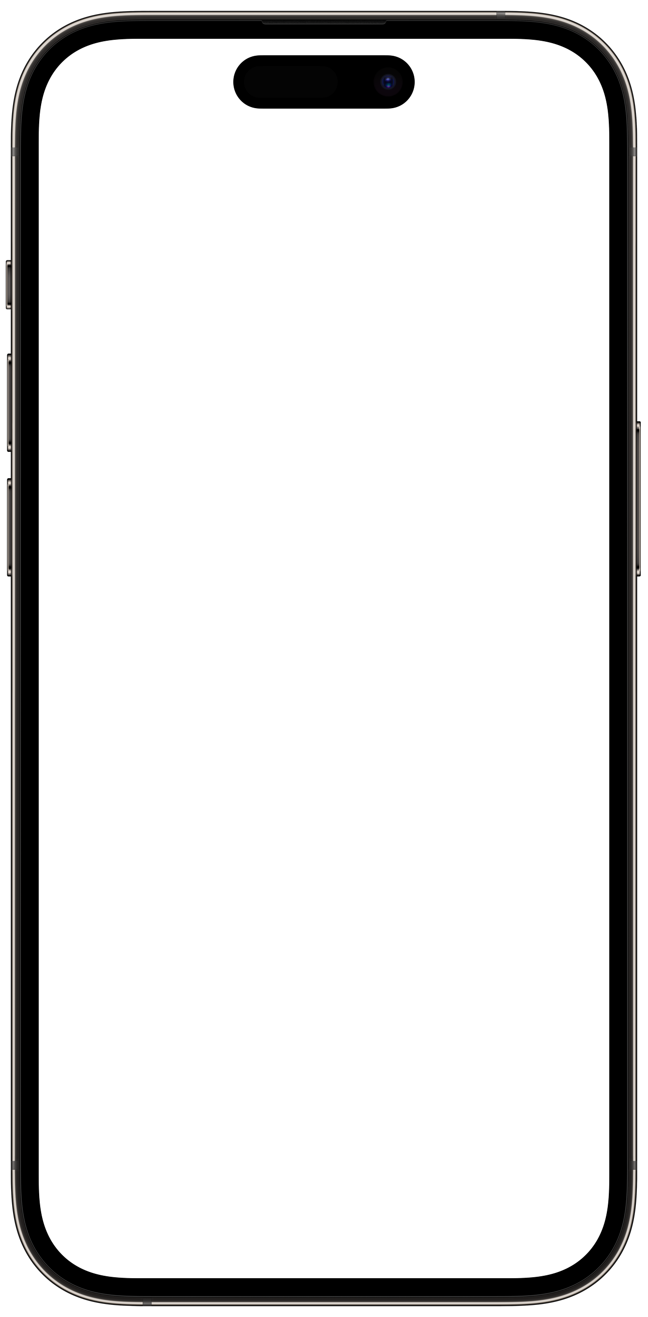

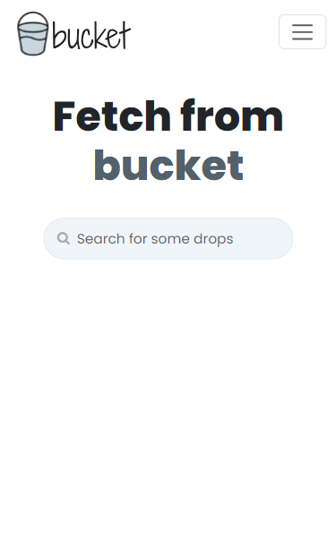

Slide 8

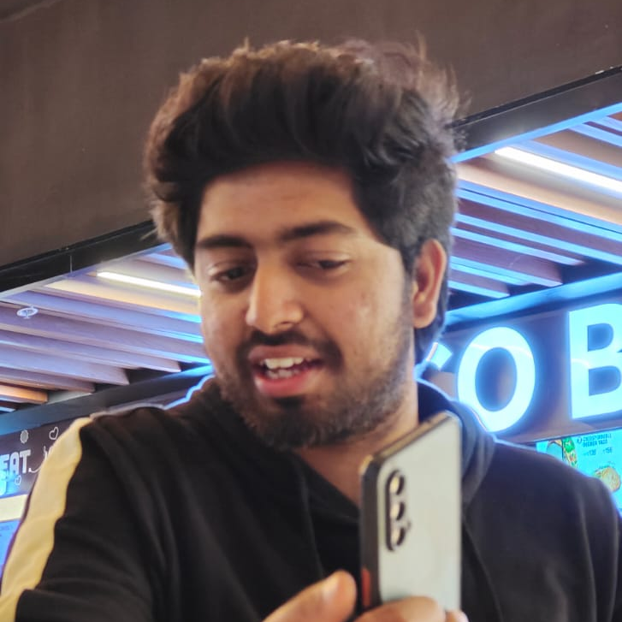
Team
Parithi Mohammed Akthar S
Nitish kumar V A

Slide 9
Thank you ?
😌

